Slide 1
CHURN PREDICTION
-By team -
Team Members: M.Haritha - 99220041246
G.Mounika - 99220041190 R.Nikitha - 99220041486 K.Guyana - 99220041487

Slide 2
Problem Statement
Abstract: In this problem, we aim to predict customer churn for a subscription-based service, such as a streaming platform or software subscription. By analyzing historical data including customer behavior, payment history, and engagement metrics, we will build a predictive model. This model will identify users who are at a higher risk of canceling their subscription. By proactively identifying potential churners, the company can tailor retention strategies, such as offering discounts, personalized recommendations, or improved customer support, to prevent customer attrition and increase customer lifetime value.

Slide 3
Analysis of Problem
The key components of the problem statement are as follows:
Objective: The primary goal is to predict customer churn in a subscription-based service to enable the company to implement proactive retention strategies and enhance customer lifetime value.
Context: The context involves a subscription-based service, such as a streaming platform or software subscription. Customer churn, the phenomenon where customers discontinue their subscriptions, is a concern for the business.
Data Utilization: Historical data is leveraged, which includes customer behavior, payment history, and engagement metrics. These datasets will be used to develop a predictive model.

Slide 4
Predictive Modeling: The main approach involves creating a predictive model that can effectively identify users at a higher risk of canceling their subscriptions. The model's output will help in focusing on customers who are more likely to churn.
Retention Strategies: Once potential churners are identified, the company plans to tailor retention strategies. These strategies may involve offering discounts, personalized recommendations, or improved customer support to deter customer attrition and increase the customer's lifetime value.
In summary, the problem centers around utilizing data analysis and predictive modeling to identify customers at risk of canceling their subscriptions. The ultimate aim is to employ targeted strategies that encourage customer retention and thereby enhance the overall value of the customer base.

Slide 5
Dataset
CUSTOMER CHURN PREDICTION 📈 | Kaggle – This is the link of the dataset.
Description: Telcom Customer Churn
Each row represents a customer, each column contains customer’s attributes described on the column Metadata.
The raw data contains 7043 rows (customers) and 21 columns (features).
The “Churn” column is our target.

Slide 6
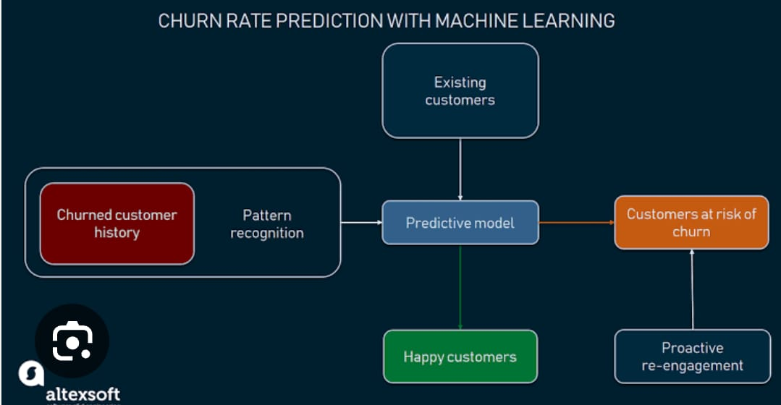
Block Diagram

